Slide 1
Computer fundamentals
By aadyaa srivastava

Slide 2
WORKING OF A COMPUTER
To function properly, the computer needs both hardware and software. Hardware consists of the mechanical and electronic devices, which we can see and touch. The software consists of programs, the operating system and the data that reside in the memory and storage devices.

Slide 3
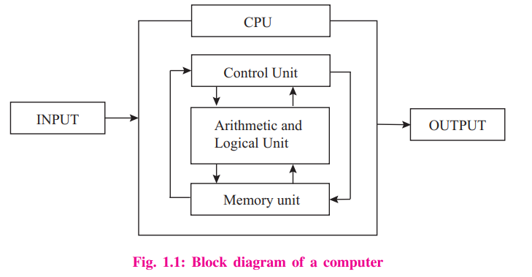
The working of a computer can be well understood by the block diagram shown

Slide 4
The working of a computer can be broadly categorized into following four functions or steps.
Receive input – Accept data/information from user through various input devices like the keyboard, mouse, scanner, etc.
Process information–Perform arithmetic or logical operations on data/ information.
Store information—Store the information in storage devices like hard disk, CD, pen drive etc.
Produce output–Communicate information to the user through any of the available output devices like monitor, printer, etc.

Slide 5
What is a Binary Number System?
Binary Number System: According to digital electronics and mathematics, a binary number is defined as a number that is expressed in the binary system or base 2 numeral system. It describes numeric values by two separate symbols; 1 (one) and 0 (zero). The base-2 system is the positional notation with 2 as a radix.
The binary system is applied internally by almost all latest computers and computer-based devices because of its direct implementation in electronic circuits using logic gates. Every digit is referred to as a bit.

Slide 6
What is Bit in Binary Number?
A single binary digit is called a “Bit”. A binary number consists of several bits. Examples are:
10101 is a five-bit binary number
101 is a three-bit binary number
100001 is a six-bit binary number

Slide 7
Facts to Remember:
Binary numbers are made up of only 0’s and 1’s.
A binary number is represented with a base-2
A bit is a single binary digit.

Slide 8
Do it yourself!
49
76
88
29
56
32
18
94
100
121
Convert decimal into binary

Slide 9
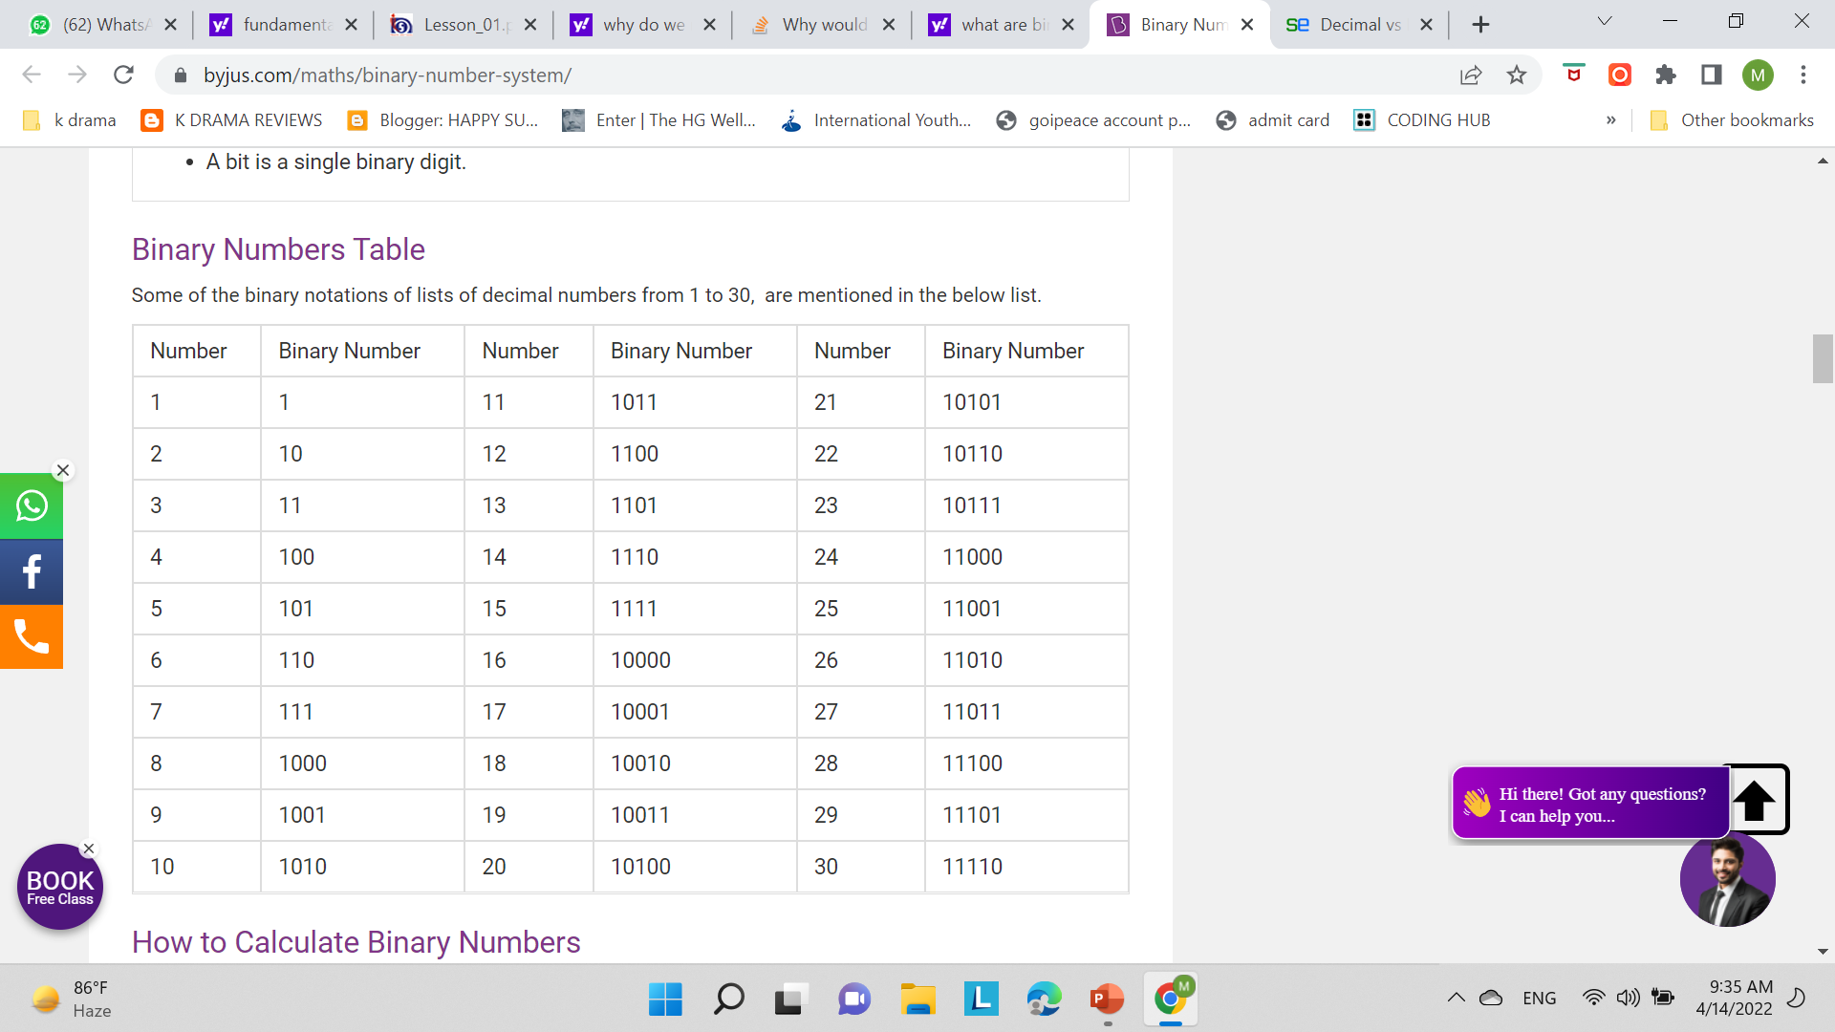
Binary no’s table

Slide 10
Decimal No
In Algebra, decimals are one of the types of numbers, which has a whole number and the fractional part separated by a decimal point. The dot present between the whole number and fractions part is called the decimal point. For example, 34.5 is a decimal number.

Slide 11
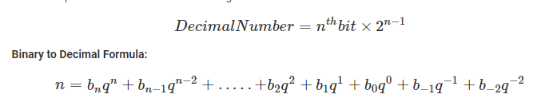

Slide 12
Example of Binary to Decimal Conversion:
Convert the binary number (1101)₂ into a decimal number.
Solution:
Given binary number = (1101)₂
Now, multiplying each digit from MSB to LSB with reducing the power of the base number 2.
1 × 2³ + 1 × 2² + 0 × 2¹ + 1 × 2⁰
= 8 + 4 + 0 + 1
= 13

Slide 13
Similarities

Slide 14
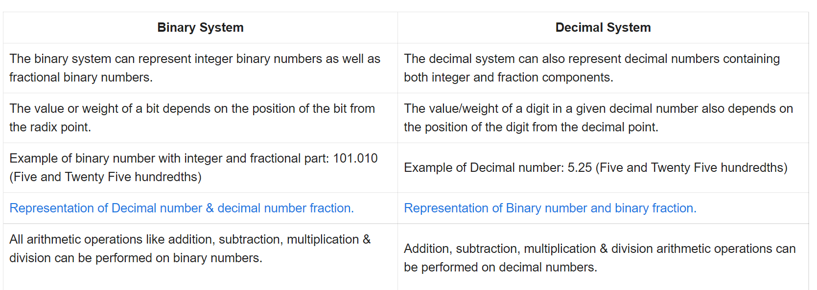

Slide 15
Differences

Slide 16
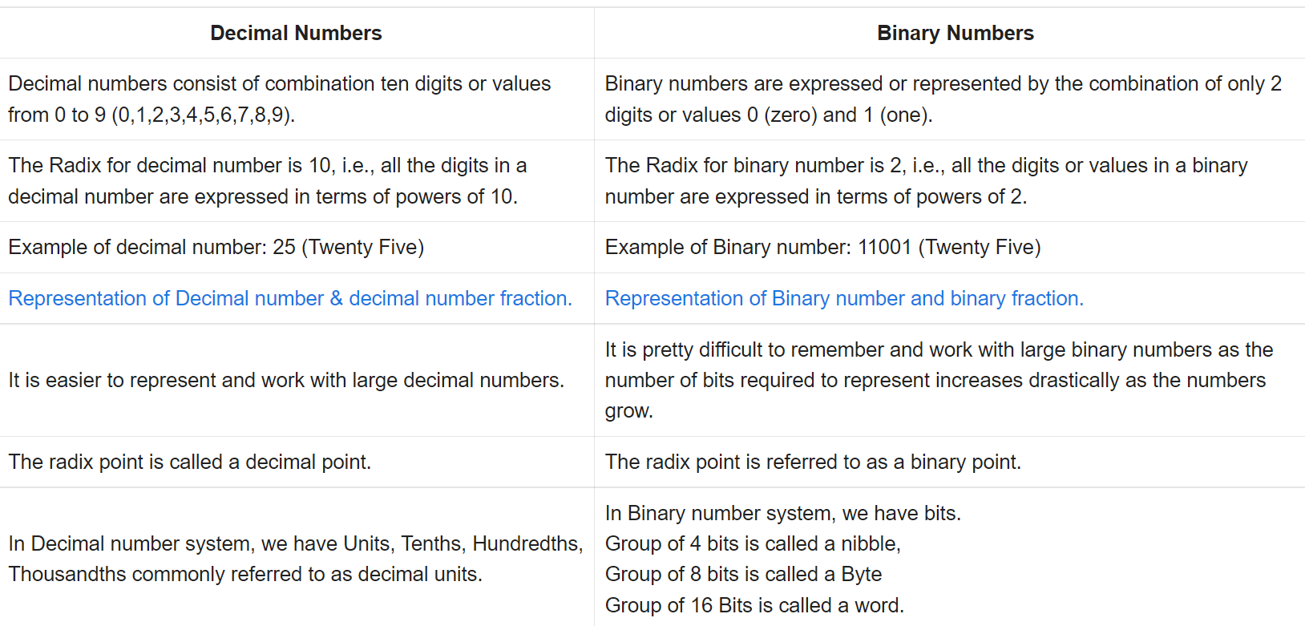

Slide 17
Hexadecimal Number: A hexadecimal number is a positional numeral system with a radix, or base, of 16 and uses sixteen distinct symbols: which are 0, 1, 2, 3, 4, 5, 6, 7, 8, 9, A, B, C, D, E, and F.

Slide 18
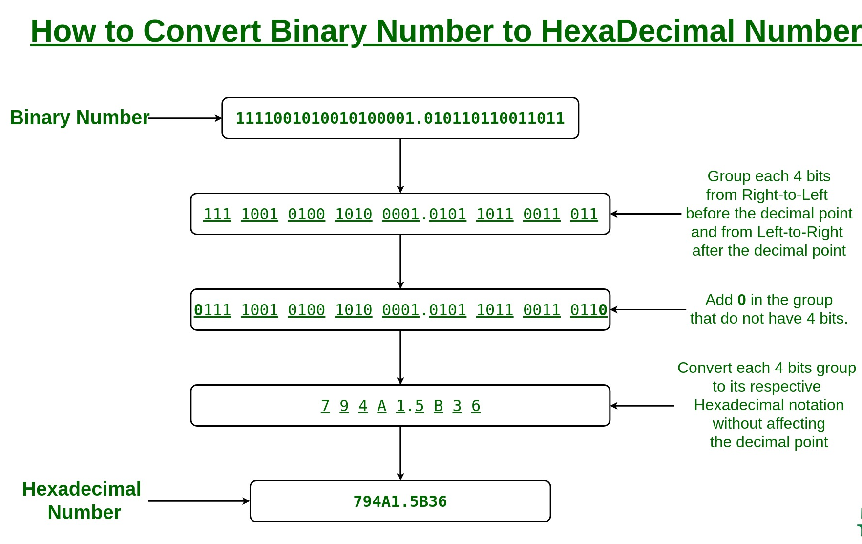

Slide 19
Important: if on grouping we don’t get a number In a group of 4 numbers then add as many zeros required to the number to make a group of 4 numbers .
Addition will be done on the left side of the number.

Slide 20
Do it yourself!
100010
1000011
1111011
10111100
11001000
1001010
1000101
101101
1011110
111110100
Convert : binary into DECIMAL THEN HEXA DECIMAL

Slide 21
Conversion of hexadecimal to binary

Slide 22
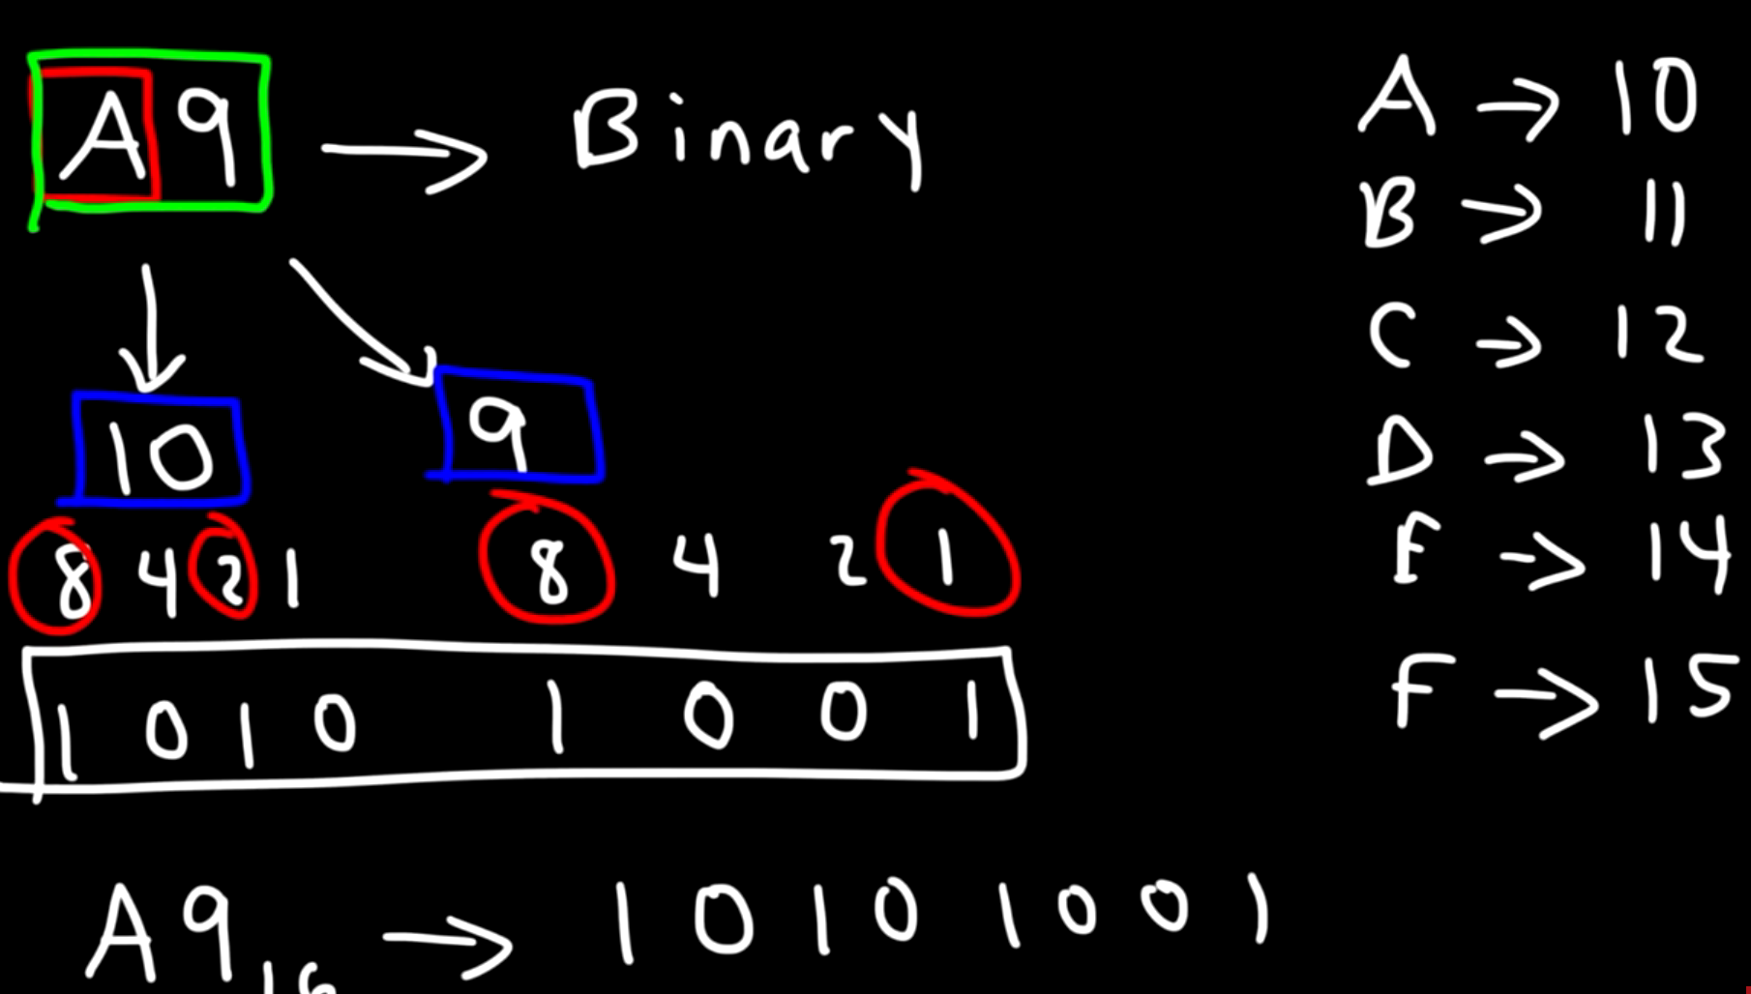

Slide 23
DOUBTS?

Slide 24
Home work
Write decimal to binary counting from 50 to 100
Write hexadecimal conversion of no from 61 to 70

Slide 25
Thankyou

